Slide 1

Project 1 – Library Data
By: Hugo Garcia; Duong Luu, Ronald Ho

Slide 2
Hypothesis the Library?
What is the deciding factor for the library circulation?
Is it population?
Is it age group?
Is it location?
Is it the sheer amount of item available at the library?

Slide 3
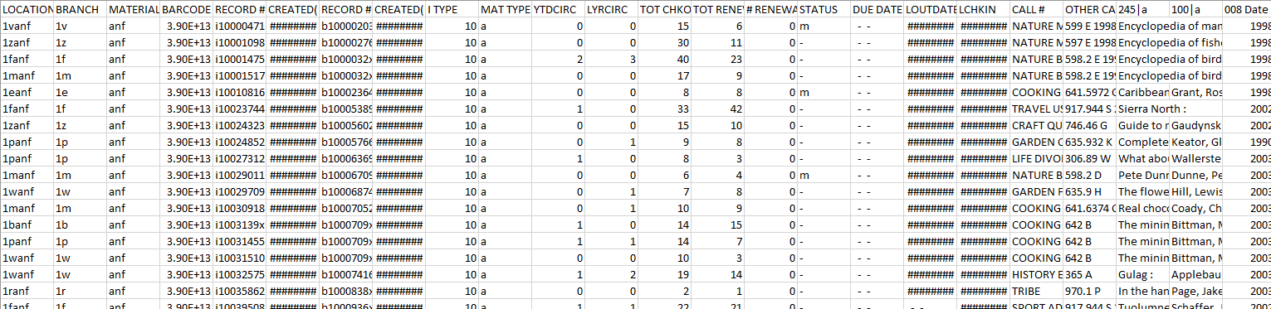
Dataset from the Library
We were able to grab a dataset with all of library items the San Mateo County Libraries owned
From there we looked over the dataset and determine which fields we want to use

Slide 4

Documentations of the Fields
From looking at the data set we are able to determine what some of the columns were
Example:
100| is Author’s field
245| is the Title field
For some we do had not clue what the data means, we had to reach out to the library to have documentations for some of their fields.
Branch Documentation
Status Documentation
Call # Documentation

Slide 5
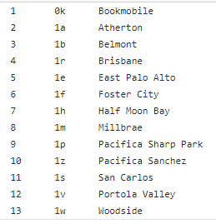
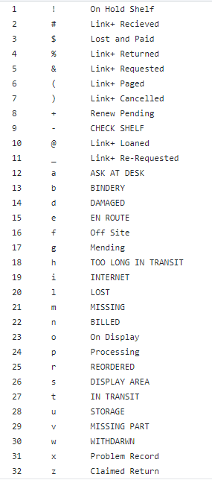
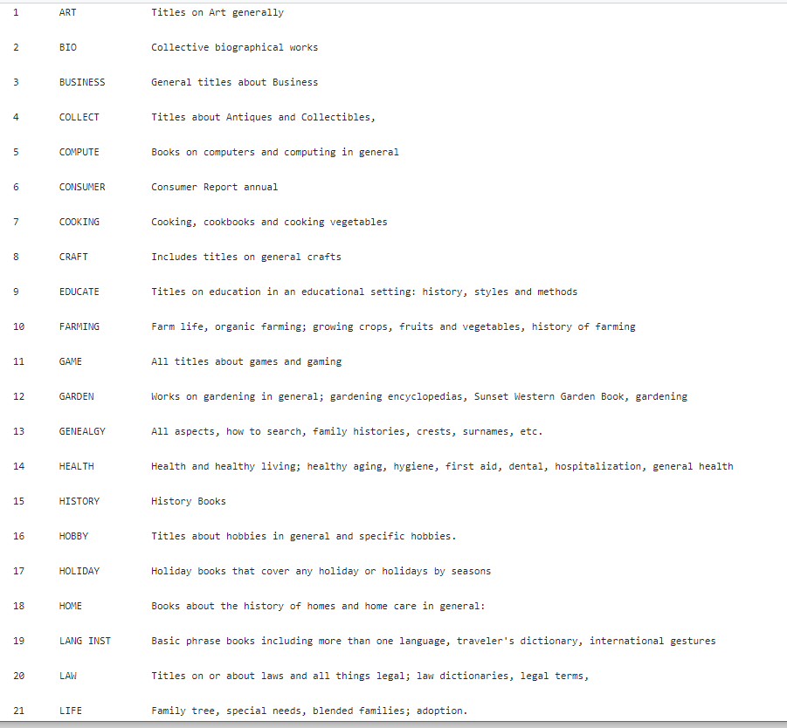
Branch Documentation
Status Documentation
Call # Documentation

Slide 6
Cleaning up the Dataset
Our first goal is to gather and look at the dataset and find to see usable data
We determine which data are useful and dropped the columns we have no use for
Using the documentations we also renamed some of the fields to have a better understanding of our data

Slide 7
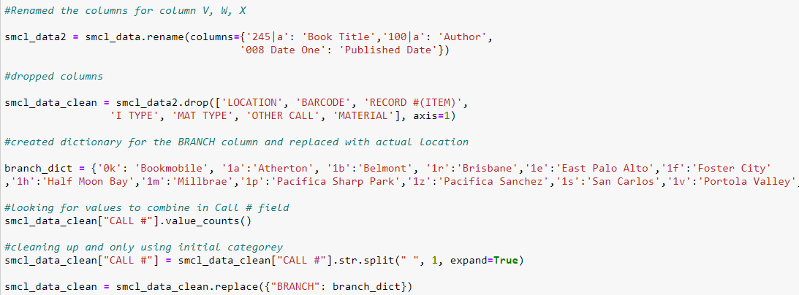
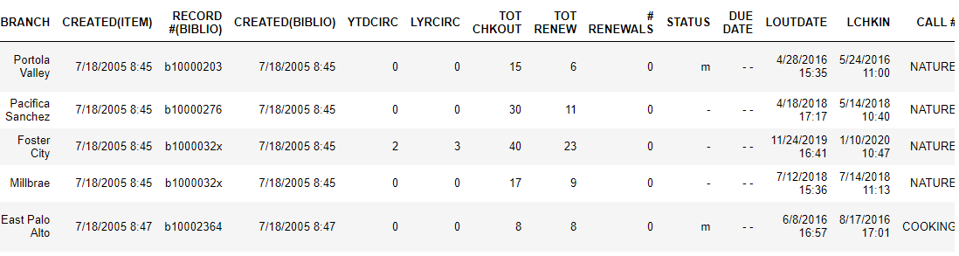

Slide 8
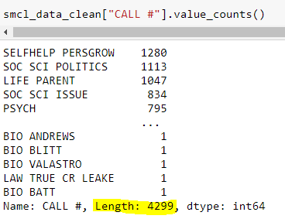

Further Clean-Up
The Library uses a Call # category classification that breaks down their Adult Non-Fiction into 39 classifications
But when we did a value_counts() on the Call # we found over 4000+ unique value.
Oh No!!!!!!

Slide 9
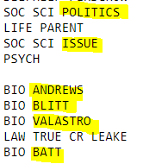
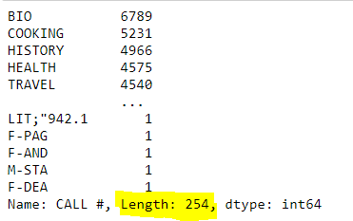

But wait why is it still 254??????
Looking at the data closely we notice patterns that the Call # follows
The have a main Category followed by a sub-category
So what we decide to do is just group these by
their “main category”. To do this all we did was
Remove all the text after a space.

Slide 10
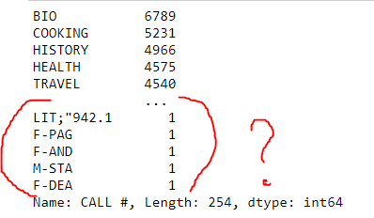
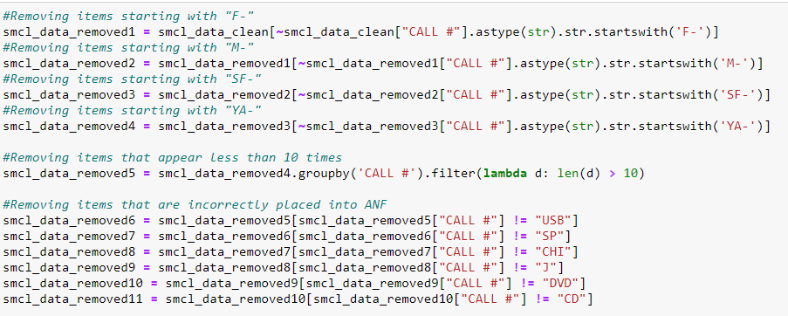

Why do we still have 254 unique values?
Like all other databases they have errors of their own. Most likely these are inputted incorrectly from their database and we should ignore it.
We removed fields that is not part of our “Call # documentation” provided by the library.

Slide 11
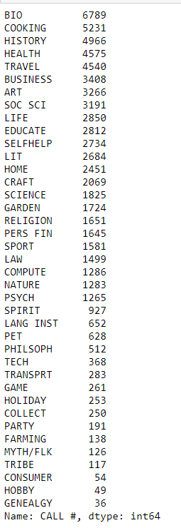
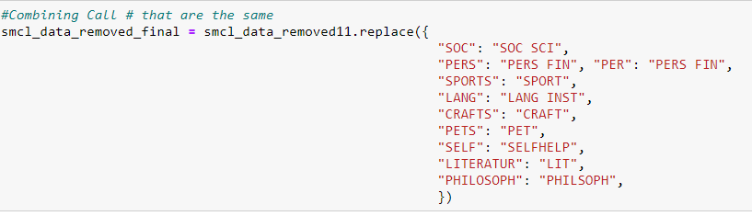
And we also combine misspelled Call # into their correct category
YEA!!!! We have our complete Call # data cleaned up.

Slide 12
Adding and Grouping of the Dataset
Now we took a closer look to see if there is any thing we can clean up or group up.
TOT CHKOUT = Total Checkout
TOT RENEW = Total Renewal
Isn’t that just the same thing? So we combined it to create a new column
TOT CIRC = Total Circulation

Slide 13
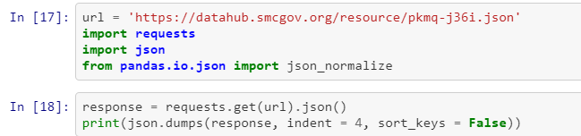
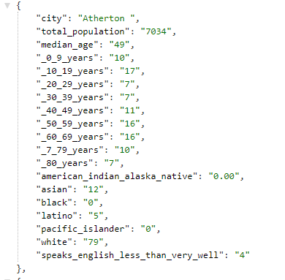
Performing a GET Request to the County of San Mateo Datahub
Performing a GET Request to the County of San Mateo Datahub

Slide 14
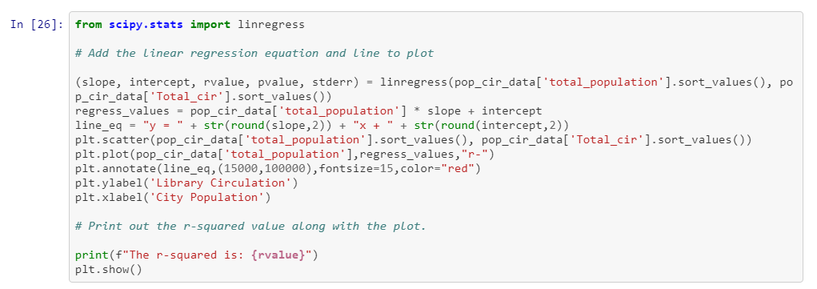
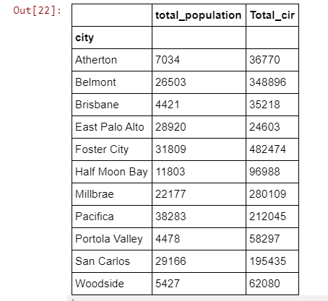
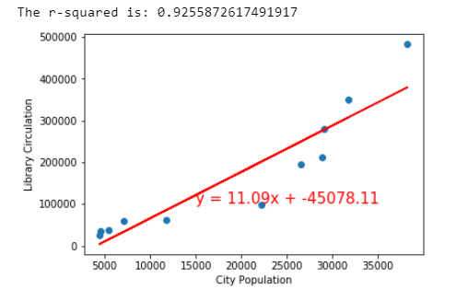
Correlation between the population and the library circulation

Slide 15
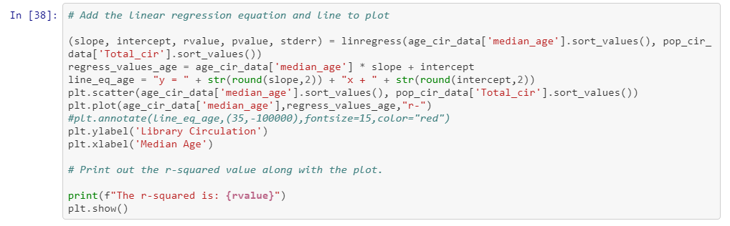
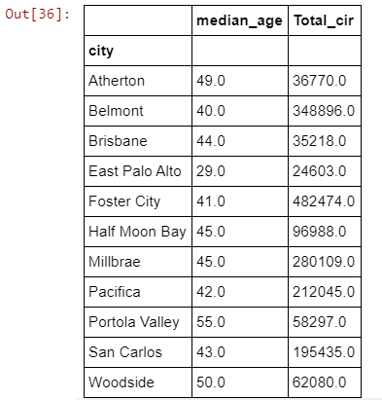
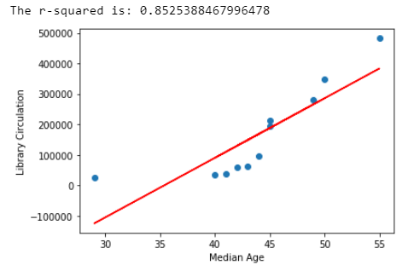
Correlation between the age groups and the library circulation

Slide 16
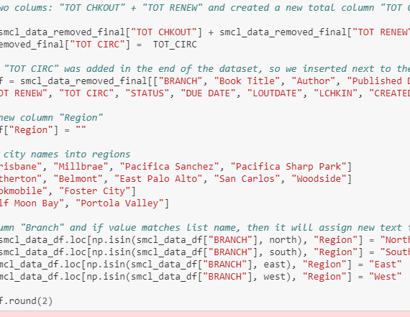
There are a total of 13 libraries and 39 Call # categories
13 x 39 = 507
Our charts will look very messy!!!!!
To make things look cleaner we broke it down by “region”
We look at each library and where each branch belongs to and broke them down by region.
[North, South, West, East]

Slide 17
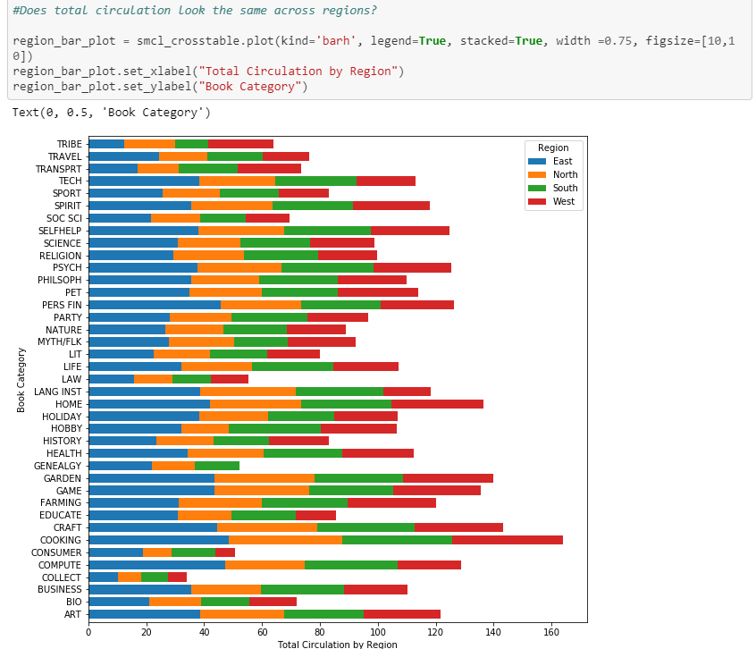
Now we can visually see if each category’s
circulation for different region
Our graph shows that “COOKING” is popular across
all region
While “ART” is shown a slightly higher in the East
Region compared to the rest
“COLLECT” is low across the board meaning no one
Collects things anymore
*But for all the categories they are even across the board

Slide 18
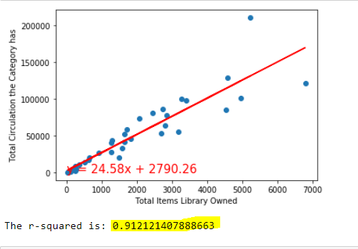
As there seems to be no difference between region we look at SMCL’s category as a whole and see if there is a correlation between the “Total number of items” to “Total Circulation”
Look at that r-value!!!!
Everything looks good up until the 3,000 mark

Slide 19
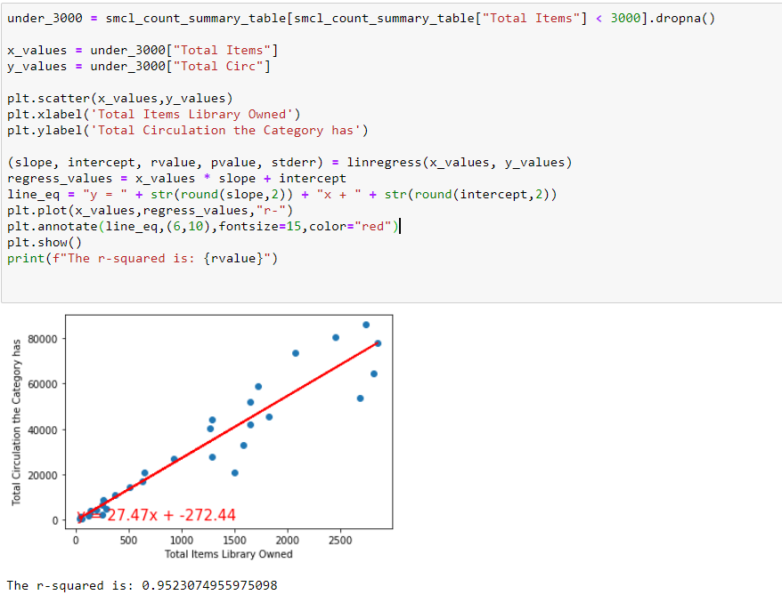
So I broke it up between “Number of items under 3,000”
The r-value is still very high

Slide 20
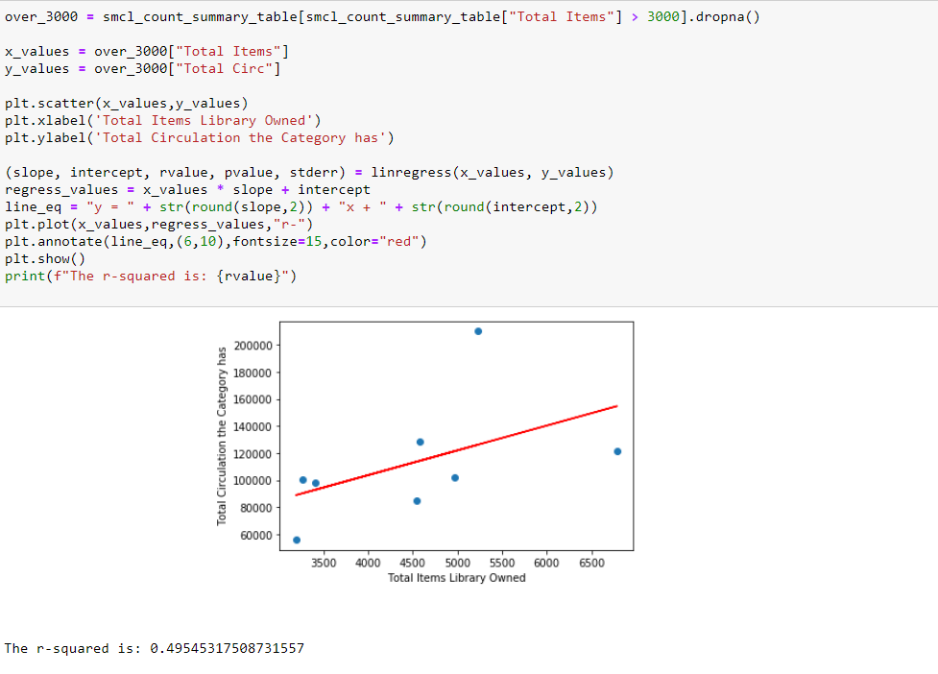
And “Number of items” above 3,000
The r-value got dropped by half

Slide 21
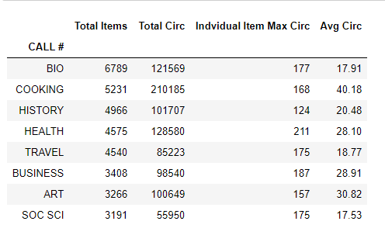
Why are items over 3,000 is getting more random?
So we took a closer look at the Top 8 categories
We looked at their “Total items, “Total Circ, Individual Max Circ,
and Average Circ of an item

Slide 22
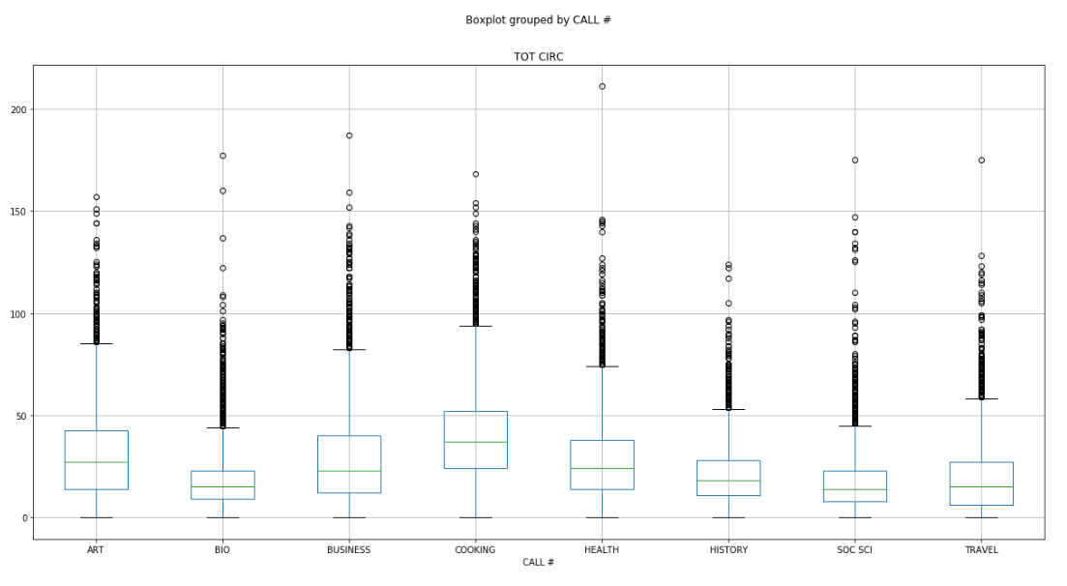
It seems that there
are titles that has circulation over their average circs
This might be caused by titles that are just super popular

Slide 23
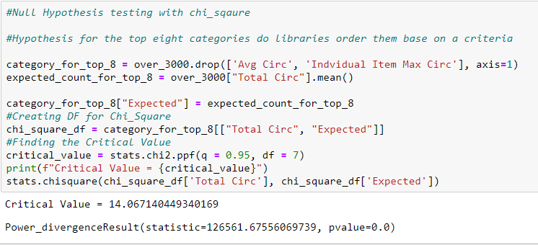
Chi-square goodness-of-fit test
We want to determine whether the results suggest patrons are more likely to borrow one book category over another category?
Since the chi square value of 126561 exceeds the critical value of 14.06, we conclude that the results are statistically significant.

